Slide 1

By:
Puneet Paul Singh-A20404848 (Leader)
Prateek Parab-A20400954
Harsh Thakkar-A20403333
STOCK-watch
Phase 2
CSP-584
Enterprise Web Applications

Slide 2
INTRODUCTION
STOCK-watch is a website which will give people an interactive platform to keep an eye on the Stock Exchange Market and manage their portfolios at the same time.
An API called “stock API” will fetch stock prices in real time to a JSON file. A pre-existing JAR i.e. json.org will convert JSON data to XML with tags.
Different roles and their responsibilities:
Admin: Manage users and Broker accounts.
Broker: A third party broker who validates the transactions of buying and selling of stocks for clients.
Client: Front end user which interacts with website to buy, sell and manage his stocks by logging in or creating a new account.

Slide 3
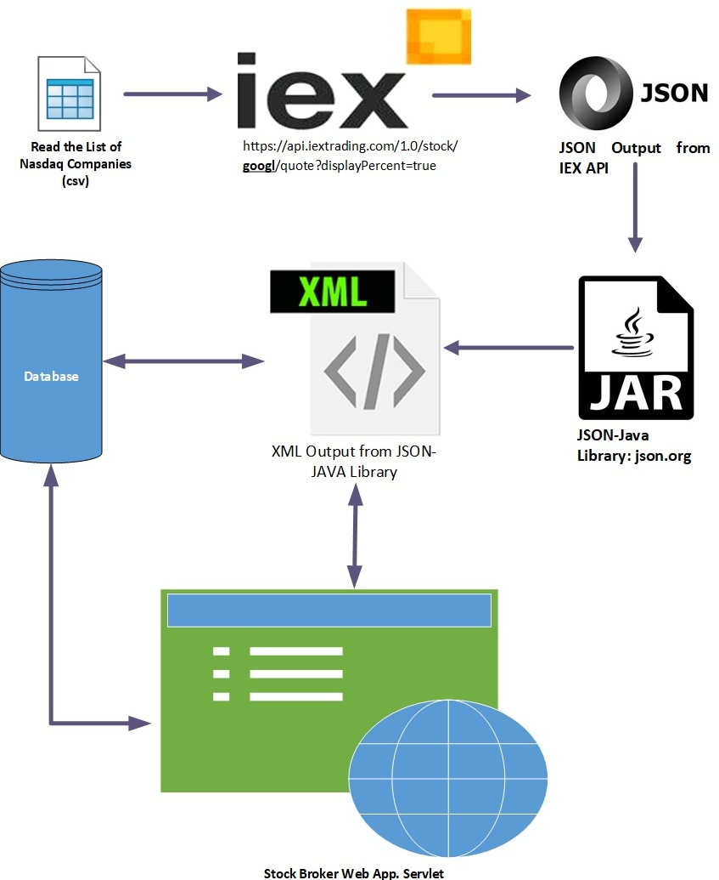
High-Level Model

Slide 4
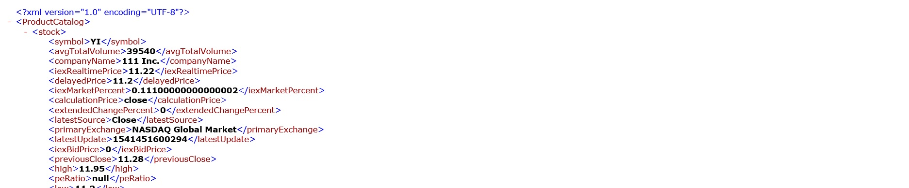
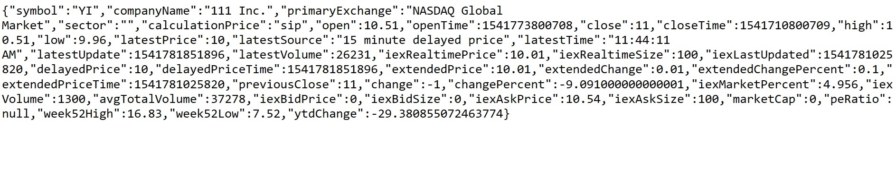
JSON To XML

Slide 5
CODE SNIPPET JSON to XML
/* JSON to XML
public static String convert_json(String json_value) {
String xml = "";
try {
JSONObject jsoObject = new JSONObject(json_value);
xml = xml +System.lineSeparator()+ XML.toString(jsoObject);
} catch (Exception e) {
System.out.println(e);
}
xml = xml +"";
return xml;
}
*/

Slide 6
CODE SNIPPET XML to DB
/* Load Data: XML To Database
public class loadproductsToDB extends HttpServlet {
public void init(){
try{
MysqlDataStoreUtilities.dropAllProducts();
Map<String,product> pMap = (HashMap<String,product>)ProductUtility.getProductMap("intiate");
MysqlDataStoreUtilities.insertproducts(pMap);
} catch (Exception e) {
e.printStackTrace();
}
}
}
*/

Slide 7

HOME PAGE

Slide 8
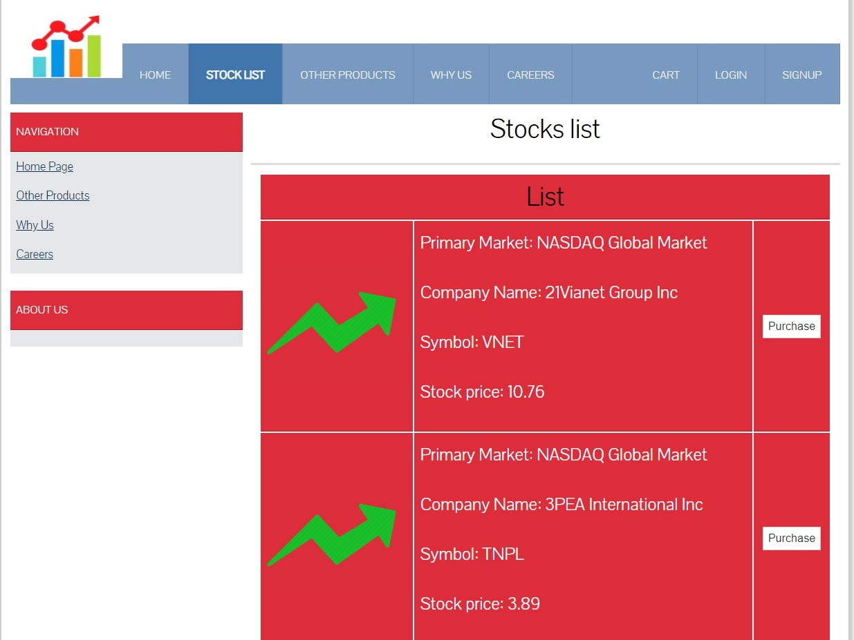
STOCK LIST

Slide 9
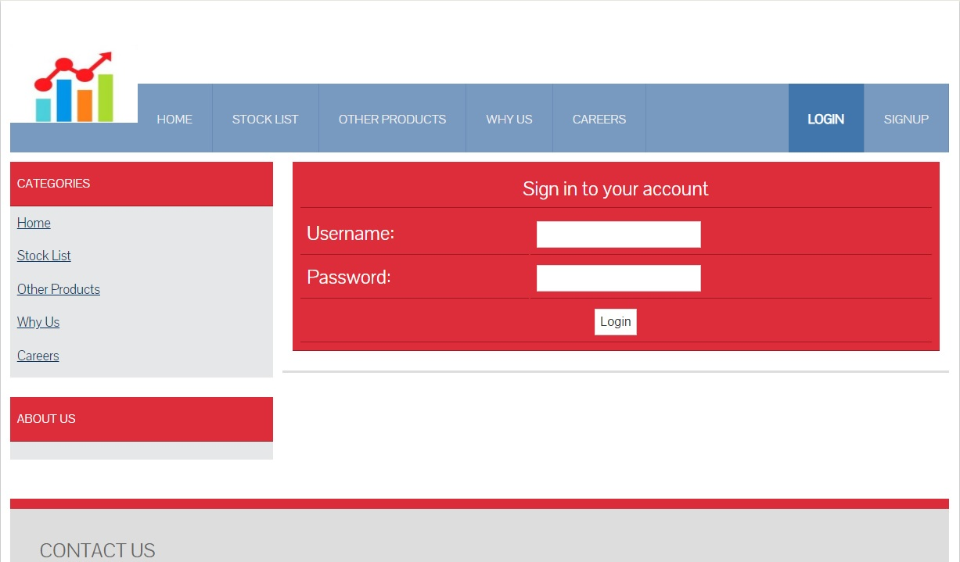
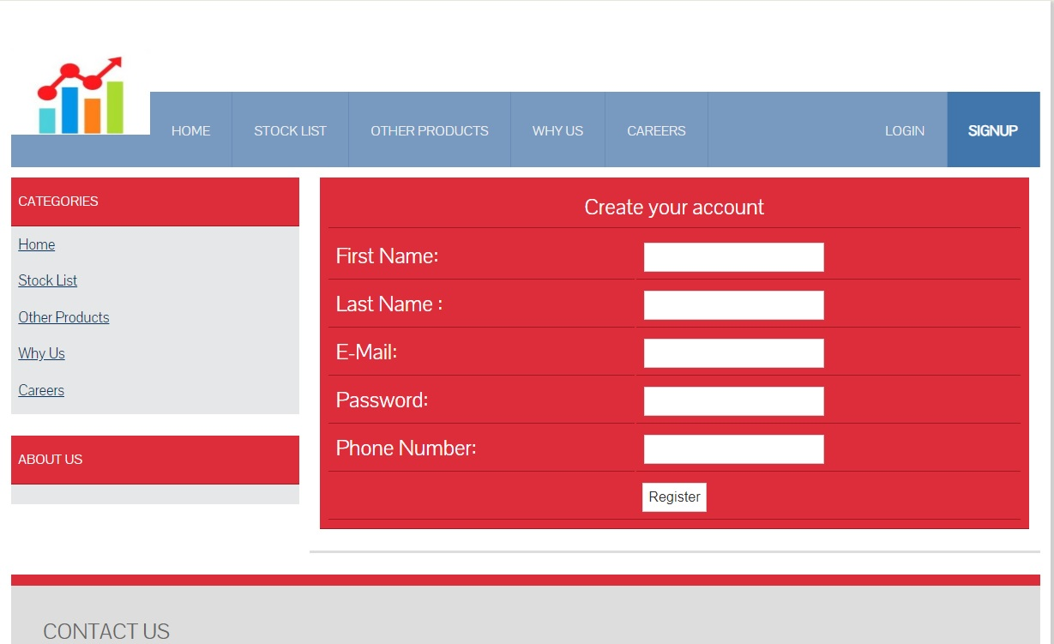
LOGIN/SIGNUP

Slide 10


Refrences:
JSON to XML jar:
http://www.java2s.com/Code/Jar/j/Downloadjsonxml21jar.htm
API:
https://api.iextrading.com/1.0/stock/TSLA/quote?displayPercent=true

